Slide 1
Longitudinally tracking neural patterns supporting long-term memory
William Mau
Eichenbaum Lab
April 26, 2019

Slide 2
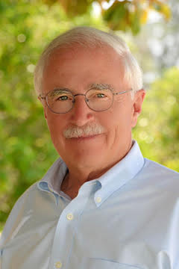
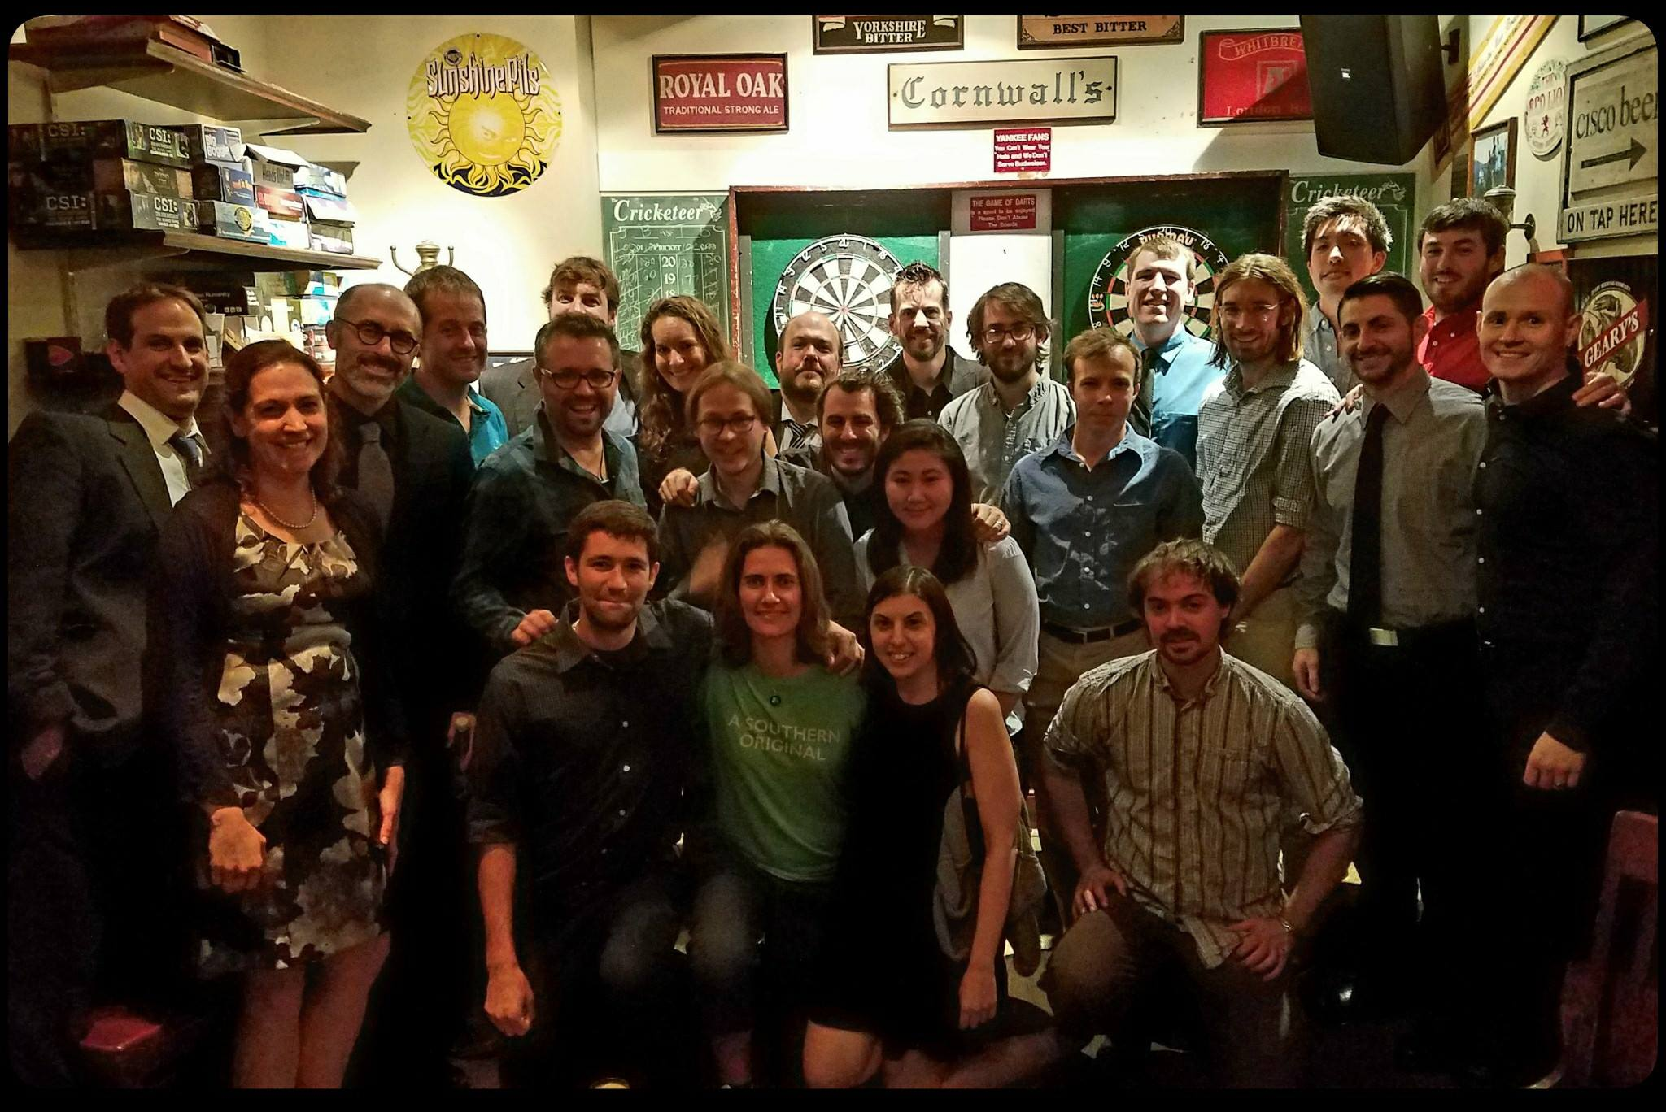

Acknowledgements
Howard Eichenbaum
Steve Ramirez
Marc Howard
Michael Hasselmo
Denise Cai
David Sullivan
Nathaniel Kinsky
Yosif (Joe) Zaki
Eichenbaum/Hasselmo/Ramirez labs
BU Neurophotonics
Shelley Russek
Sandra Jean Grasso
Nazifa Haque

Slide 3
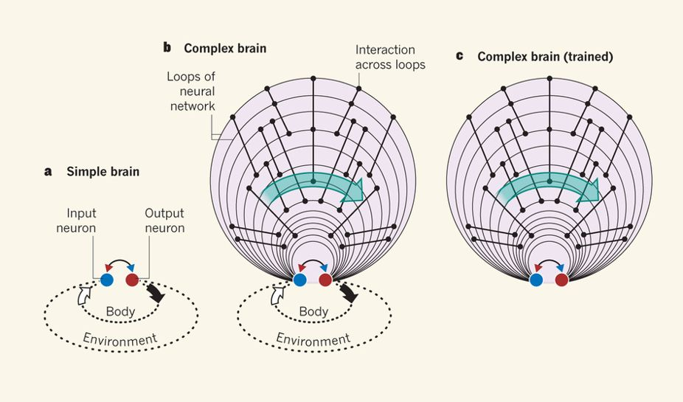
Simple brains transform sensory input into action outputs
Buzsáki, Nature, 2013

Slide 4
Complex brains establish complex relationships between sensory inputs and action outputs
Buzsáki, Nature, 2013

Slide 5
Complex brains establish complex relationships between sensory inputs and action outputs
Memory
Information storage
Buzsáki, Nature, 2013

Slide 6
A trained brain does not require sensory input to act
Buzsáki, Nature, 2013

Slide 7
A trained brain does not require sensory input to act
Reminiscence
Mental time travel
Buzsáki, Nature, 2013

Slide 8
Central questions
How are these “loops” stored in the brain?
How do they evolve over time?

Slide 9
Outline of experiments
Observing neural sequences over long timescales.
Recollection of a fearful memory.

Slide 11
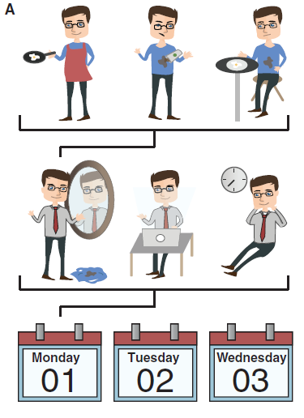
Episodic memories are events embedded in nested timelines
Miller, Frankland, & Josselyn, Curr Biol Dispatches, 2018

Slide 12
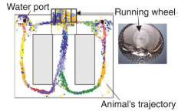
Pastalkova et al., Science, 2008

